Slide 1


ENGG404 - Lecture Case 3: The Imperative for Effective Safety Leadership and “Darker Shades of Blue”
Fundamentals of RM
RM System and Process
Leadership in RM
Incident Investigation
RM Tools & Challenges
RM in Industry
People & Org.
Application and Perspectives
On Becoming A Leader In Risk Management

Slide 2
Learning Outcomes:
Argue in favour of why leadership is critical to success of the organization.
Develop your personal commitment to safety, and carry this lesson forward especially when you are responsible for creating the right safety culture.
Case 3: “Darker Shades of Blue”
2

Slide 3
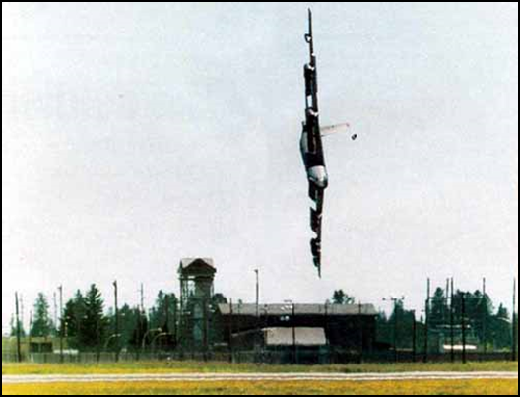
Discussion on the Incident:
Overall what happened?
Incident description (in a few words)
The sequence of events.
What caused it to happen?
Focus on technical factors and technical limitations
Focus on human behaviours, attitudes, and decisions
You have seen the video and have read the articles on eClass. Let’s get into some discussion …
Case 3: “Darker Shades of Blue”
3

Slide 4
Sequence of Events – Broad Terms:
The pilot took the plane into a highly banked turn at low altitude.
The air foils (wings) lost lift due to the highly banked turn (high angle).
At low altitude, there was insufficient space for the pilot to recover lift and resume flying the plan.
Case 3: “Darker Shades of Blue”
4

Slide 5
Sequence of Events – Detailed
As the B52 entered its final turn sequence around the tower, its airspeed indicator (ASI) was showing 182 knots (337 km/h; 209 mph). Although Holland increased the engine power after starting the turn, his input came too late to maintain the aircraft's airspeed, as the B52 turbofan engines take up to eight seconds to respond to throttle commands.
Eight seconds before impact, the airspeed had dropped to 145 knots (269 km/h; 167 mph) and the aircraft's bank angle had increased beyond 60°. This was the point at which Holland or McGeehan applied full right spoiler, right rudder, and nose-up elevator; however, due to the reduction in airspeed the aircraft entered a turning flight stall (also called an "accelerated stall").
Due to the bank angle of at least 60°, the stall speed for the aircraft at that moment was 147 knots (272 km/h; 169 mph). Hence, as it was flying 2 knots below the stall speed, the aircraft stalled, with insufficient altitude to recover before striking the ground.
Case 3: “Darker Shades of Blue”
5

Slide 6
Immediate Causes:
Pilot banked plane too hard (SP)
Pilot did not follow operating procedures (SP)
Plane could not handle the bank angle (SC)
And was never designed to handle that bank angle
Case 3: “Darker Shades of Blue”
6

Slide 7
Basic Causes – Job Factors & Personal Factors:
Personal Factor: Improper Motivation
Senior staff did not enforce flight rules and flying standards for 3 years
Never grounded “Bud” for unsafe flying
3 incidents in <1 yr personally witnessed by mgmt.
Poor communication
Turnover in senior staff (10+ people in 3 yrs)
Verbal reprimands never written down, or passed to new senior mgmt.
Junior staff did not do anything; saw nothing was being done
Demoralized
discouraged further reports
Refusal to fly
Job Factor: Inadequate Communication
Personal Factor: Perceived mental or psychological stress
Case 3: “Darker Shades of Blue”
7

Slide 8
Summary - Learning Point About Leadership:
Failure to secure the commitment of leadership oversight (in risk management) sets the stage for disaster.
Latent Causes of the Incident:
Organizational culture tolerated pilot’s behaviour
Senior Mgmt were complacent in addressing the pilot’s behaviour
Aligns with RMS Element #1: Management Leadership, Commitment, and Accountability
For the above point “Failure to secure commitment …”, reflect on the negative examples from the study of this loss incident.
Were there any positive examples?
Case 3: “Darker Shades of Blue”
8

